Slide 1

Sprint Review 1
Thursday, 17th September

Slide 2








The Team 👋
Jamie

Slide 3
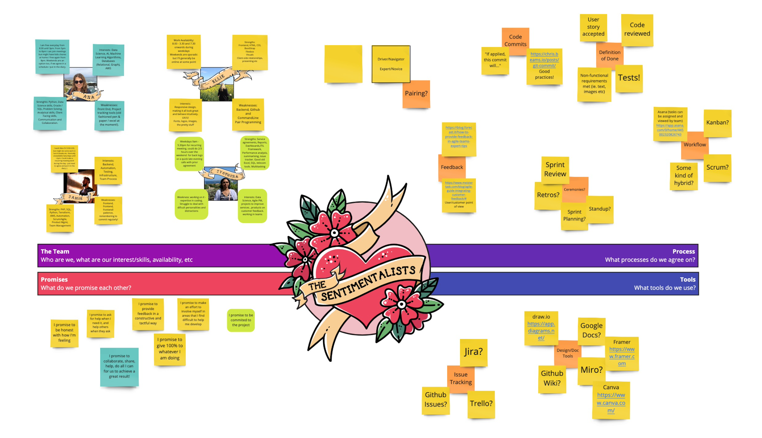
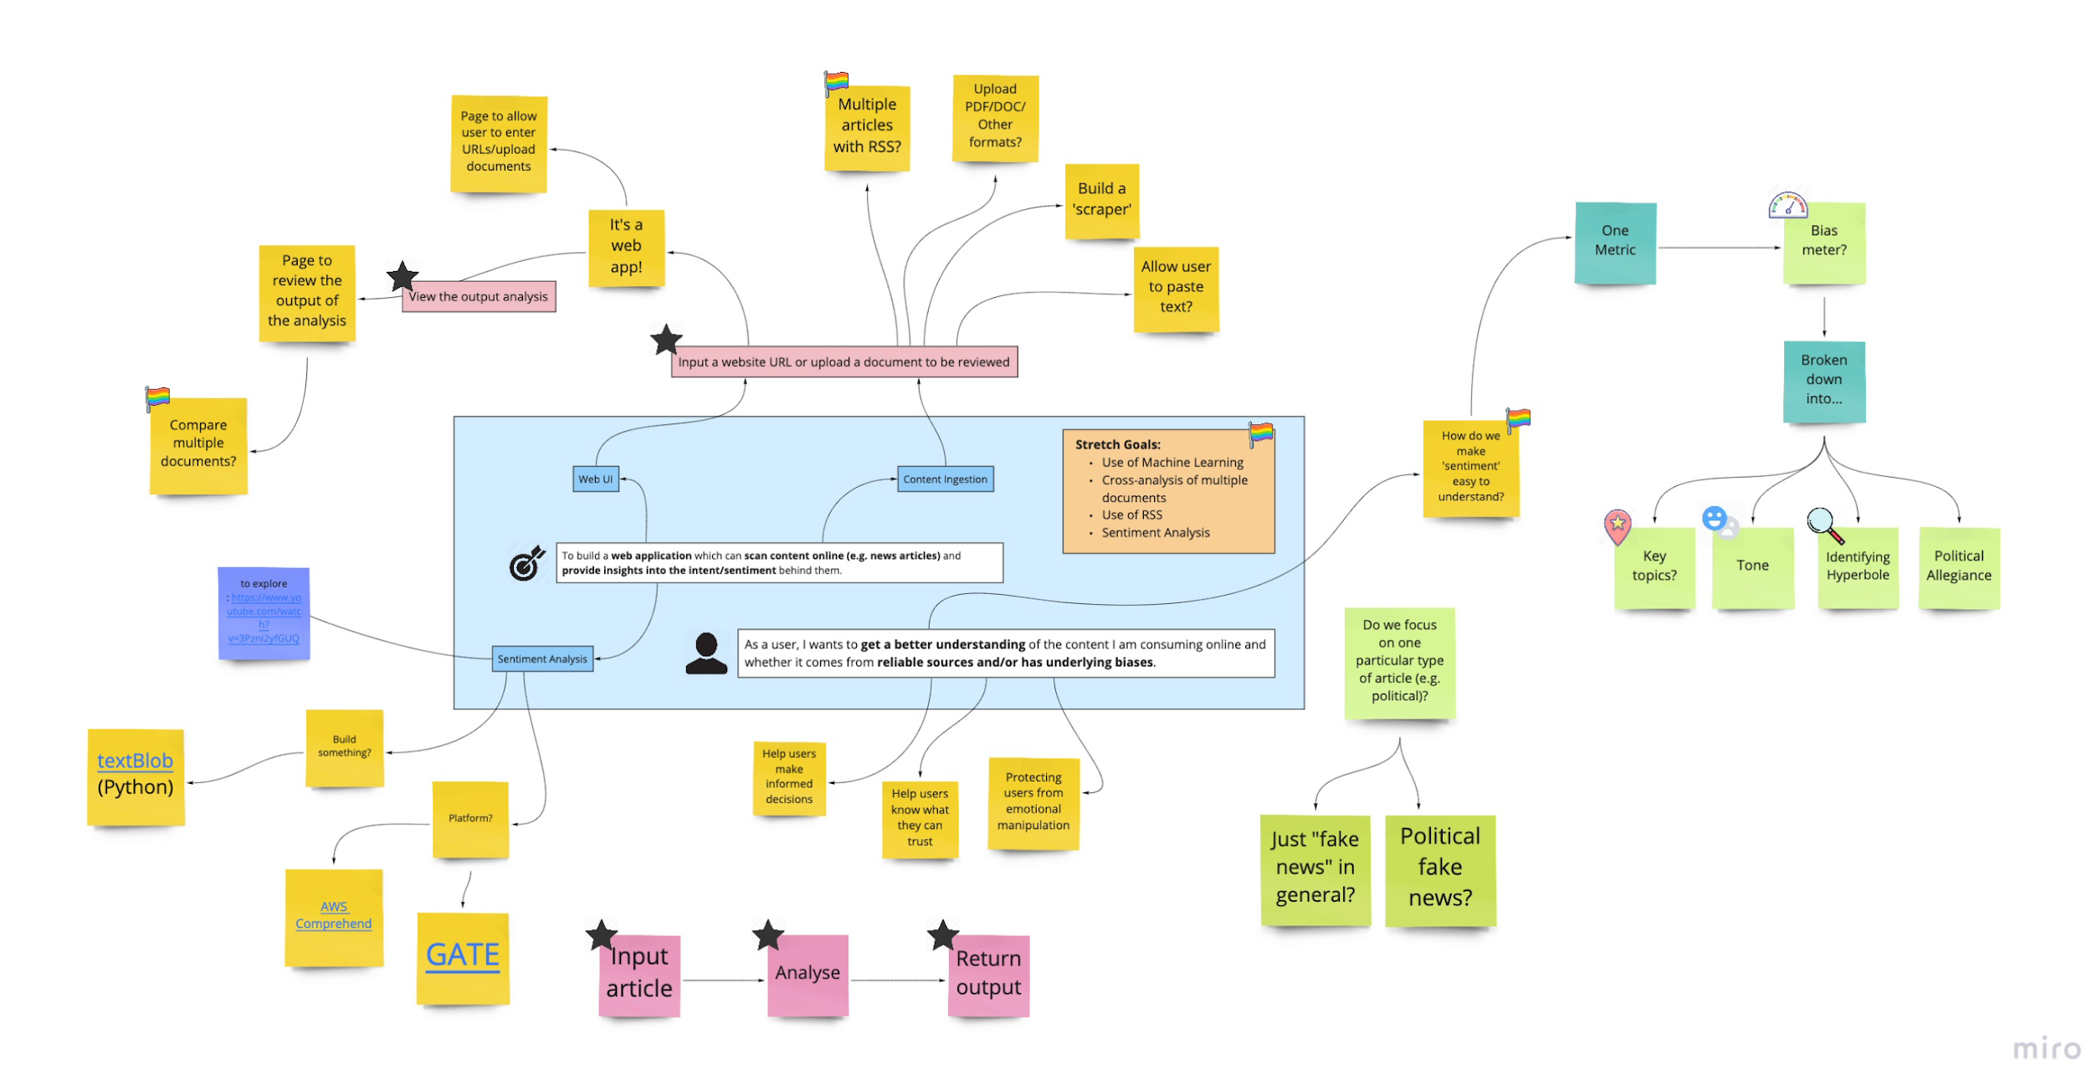
What we’ve been working on 👩‍💻
Getting to know each other!
Understanding each other: availability, interests/skills and weaknesses.
Deciding how to work together: choosing tools, setting standards.
Breaking down the problem: Drawing wireframes, researching backend options
Ellie

Slide 4
Our Working Methodology 🤝
Agreed on regular meetings (Mon-Fri 9am)
Coding standards (commits, filenames, consistency)
Agile & lean methods
Jyothsna

Slide 5
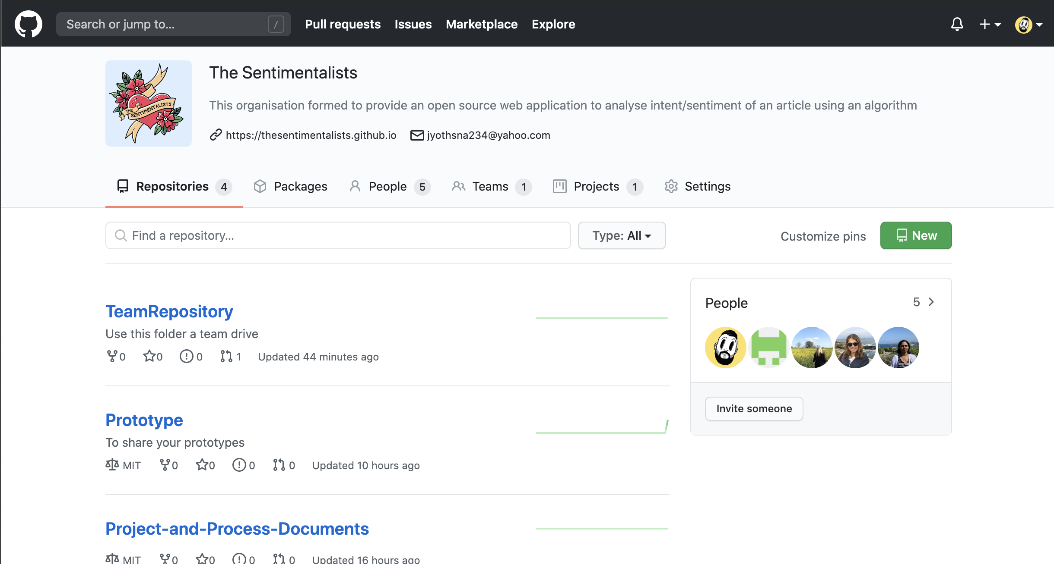
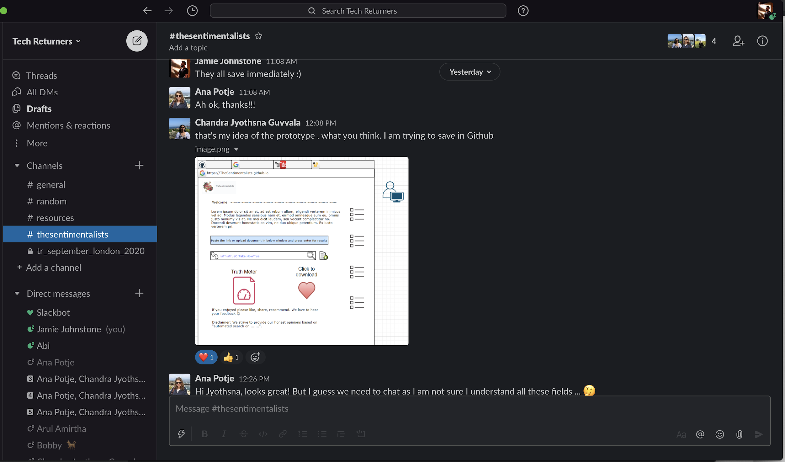
Our Tools 🔧
Team Storage/Code Repository: Github
Issue trackers: Github Issues, Clubhouse, JIRA, Trello
Communication: Slack for chat, Zoom for video calls/pairing
More decisions to be made as we dive in deeper!
Jyothsna

Slide 6
Our Ideas 💡
Explored the problem space
Looked at competitors (e.g. Signal AI)
Broke down the problem: ingestion, document retrieval, analysis, output
Explored how to communicate ‘sentiment’ to an end user
Explored what’s possible with existing technology/libraries/ML
Jamie
Notes:
Explored the problem space
Looked at competitors (e.g. Signal AI)
Broke down the problem: ingestion, document retrieval, analysis, output
Explored how to communicate ‘sentiment’ to an end user
Explored whether to focus on one topic (e.g. just politics) or a ‘general solution’
Explored what’s possible with existing technology/libraries/ML
Explored stretch goals: fetching via RSS, comparing documents, machine learning

Slide 7
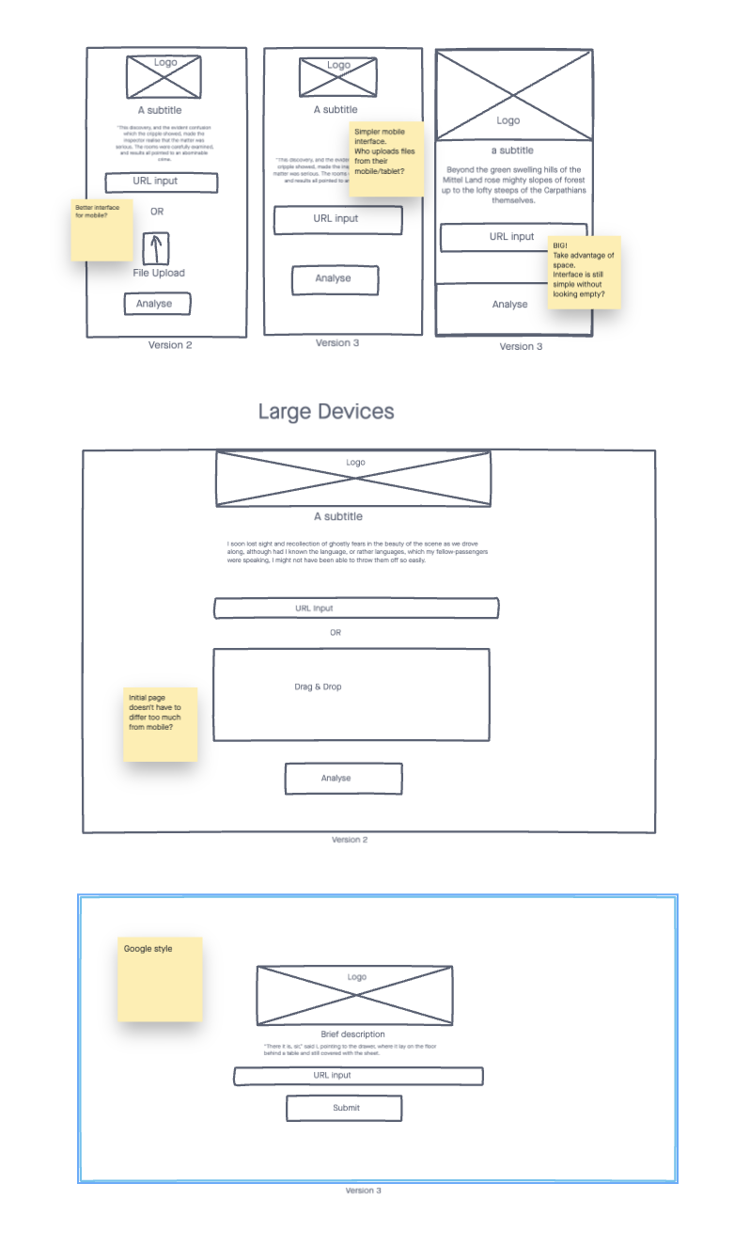
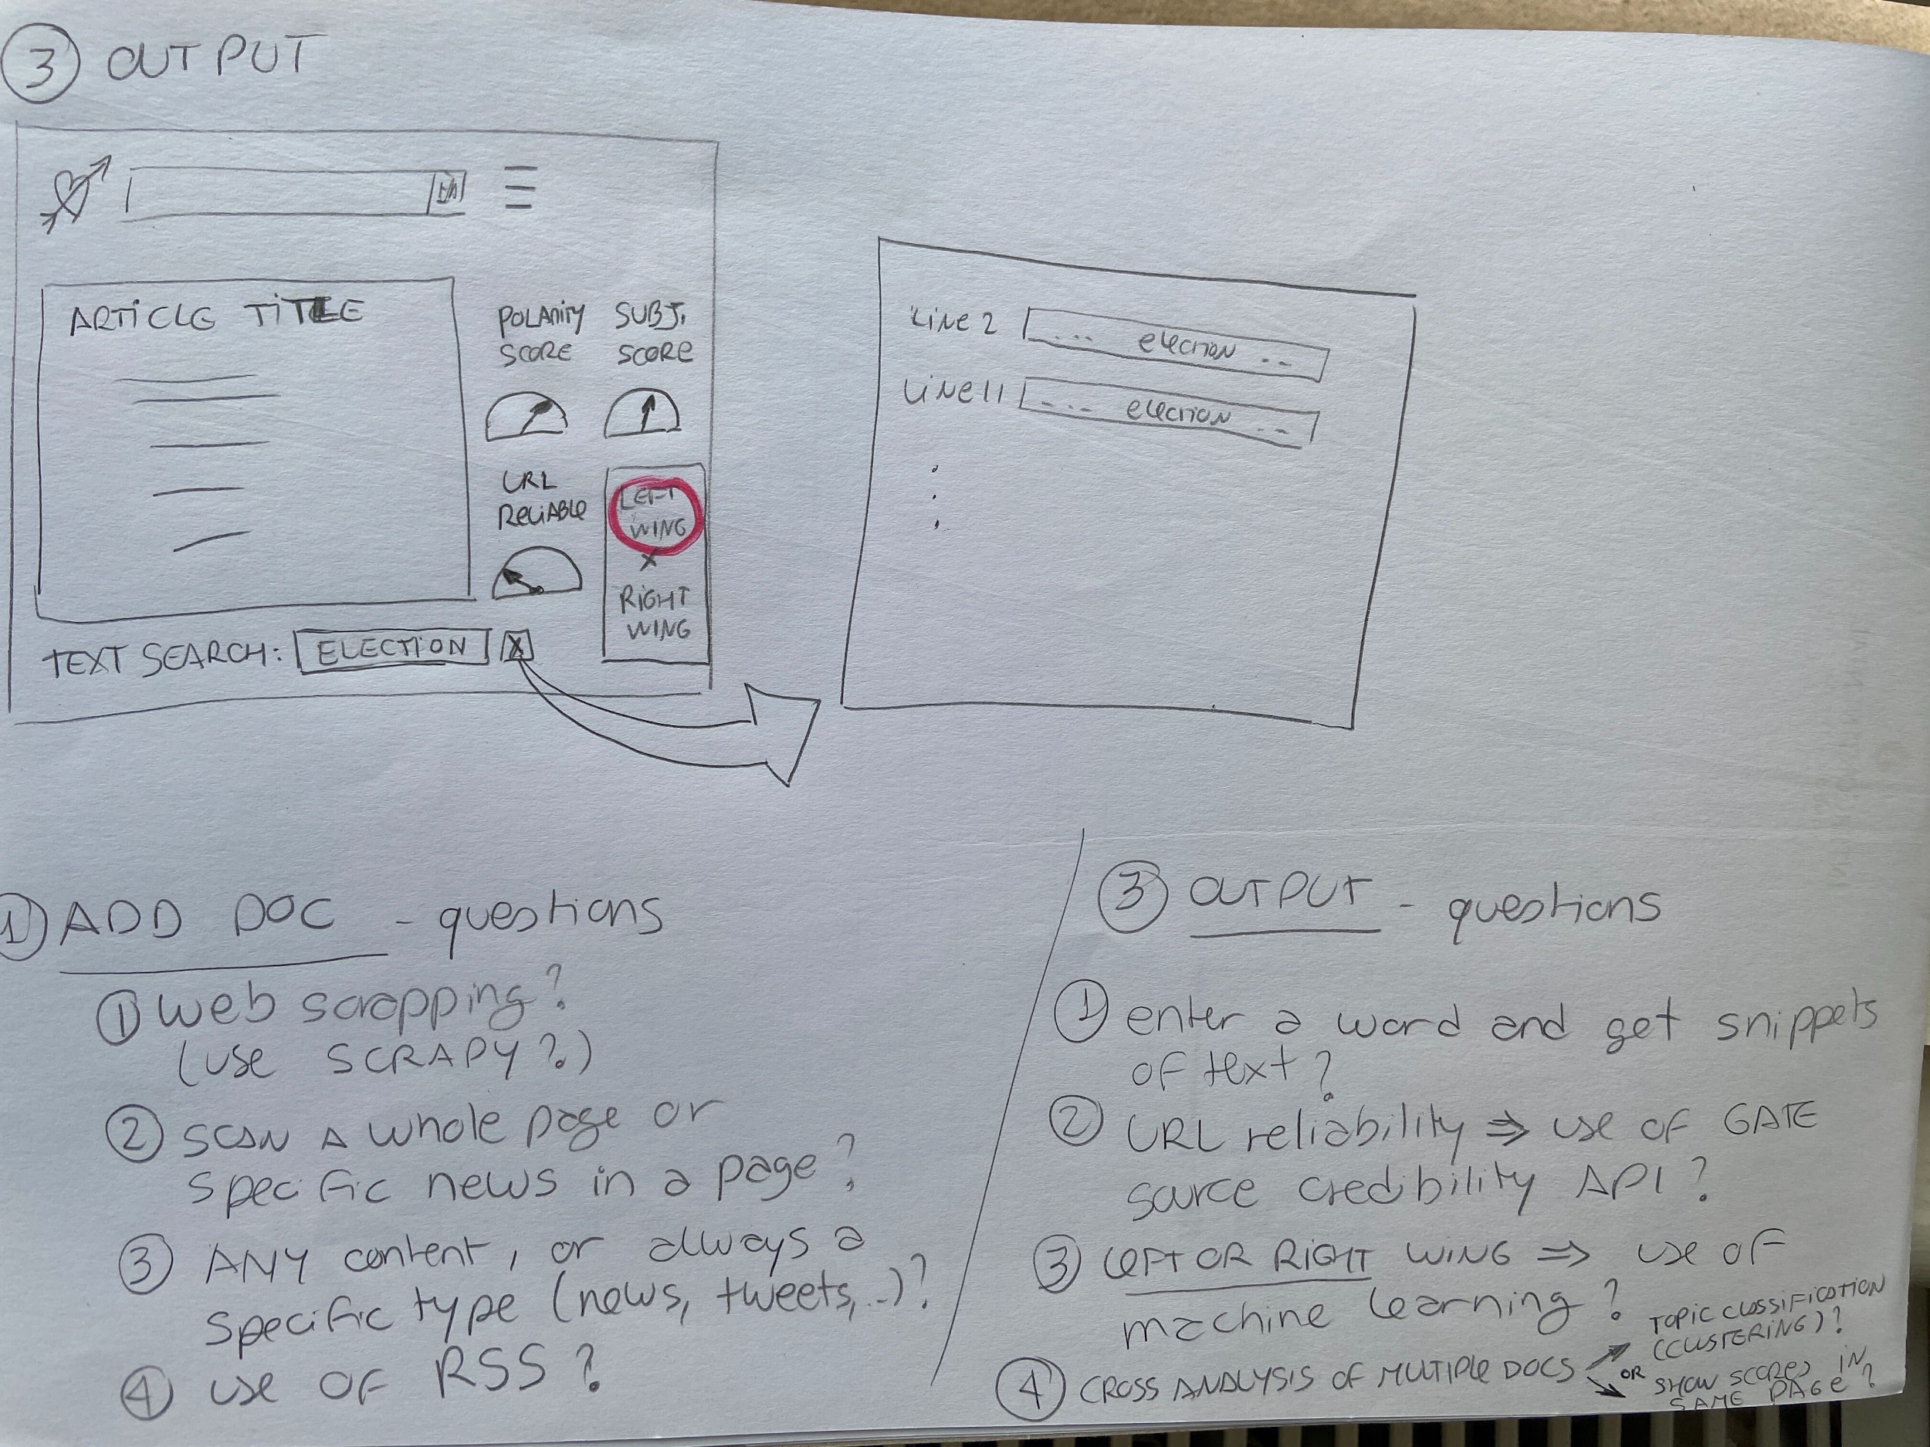
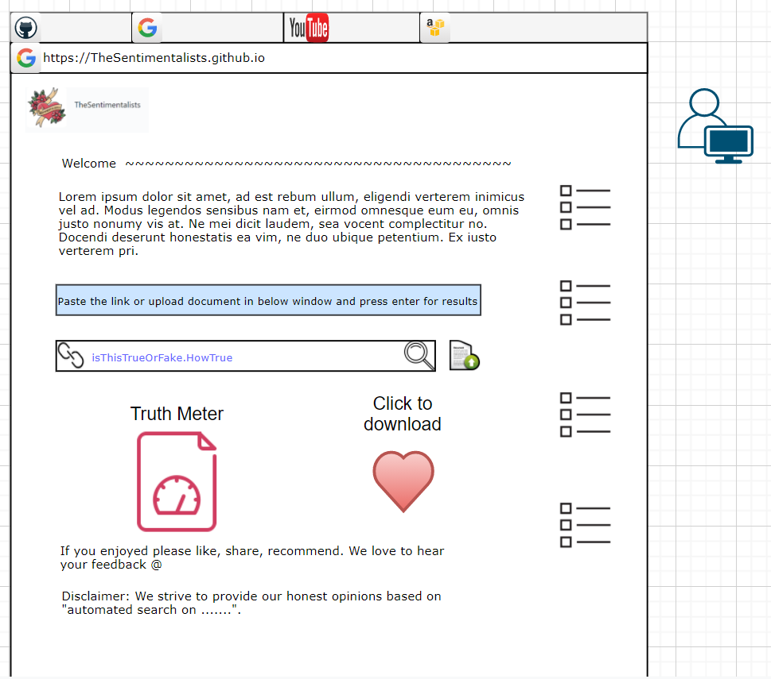
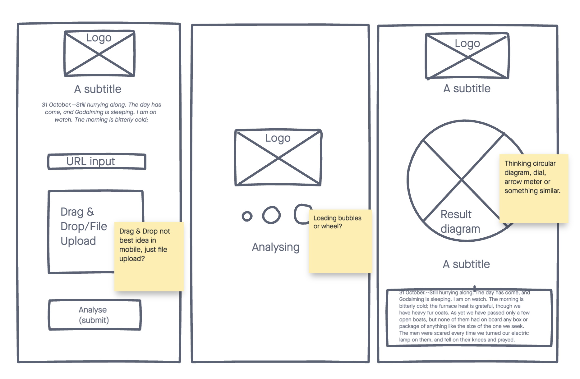
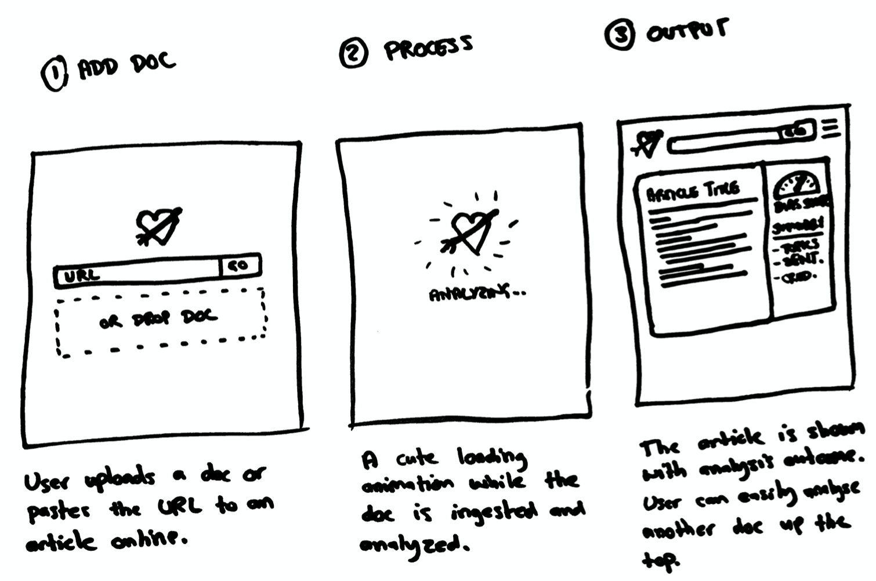
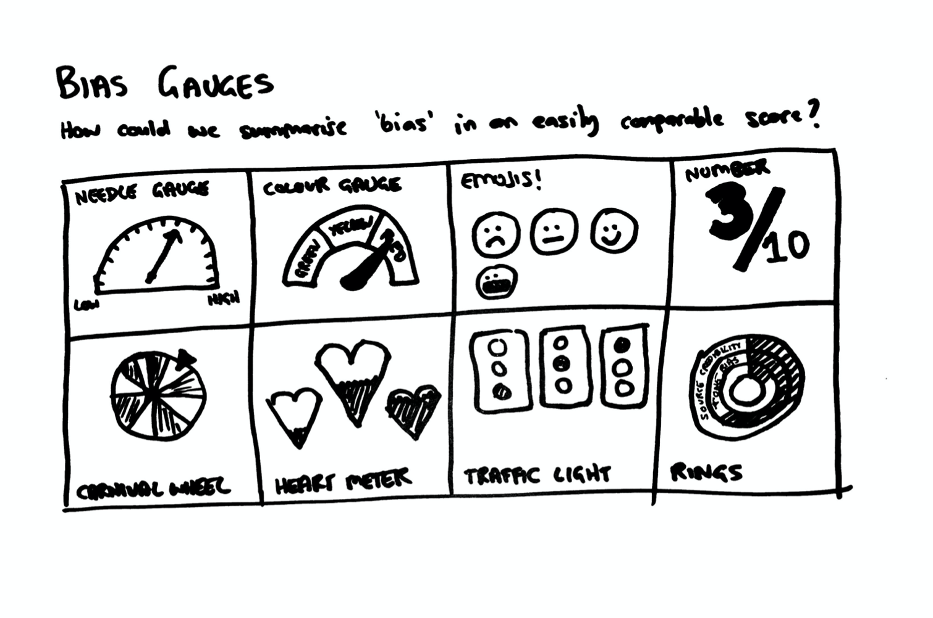
Our Ideas - Front End 🎨
Ellie

Slide 8
Our Solution - Input 👀
Website URL X upload a document to be reviewed
Looking at Scrapy, BeautifulSoap - we haven’t found a “generic” solution yet...
Type of content
Possibly focusing on News Articles but considering other options.
Search Feature
Input of a specific word and present all snippets of text where it is found.
Context is shown / whole sentence.
Ana
Notes:
Explored the problem space
Looked at competitors (e.g. Signal AI)
Broke down the problem: ingestion, document retrieval, analysis, output
Explored how to communicate ‘sentiment’ to an end user
Explored whether to focus on one topic (e.g. just politics) or a ‘general solution’
Explored what’s possible with existing technology/libraries/ML
Explored stretch goals: fetching via RSS, comparing documents, machine learning

Slide 9
Our Solution - Output 📈
Polarity Score
Negative / Positive sentiment analysis - Python library TextBlob
Subjectivity Score
Objective / Subjective text analysis - Python library TextBlob
URL Reliability
Looking into GATE Source Credibility API
Others
Cross-analysis of docs - Python libraries gensim or spaCy
Left Wing / Right Wing - use of Machine Learning (?)
Ana
Notes:
Explored the problem space
Looked at competitors (e.g. Signal AI)
Broke down the problem: ingestion, document retrieval, analysis, output
Explored how to communicate ‘sentiment’ to an end user
Explored whether to focus on one topic (e.g. just politics) or a ‘general solution’
Explored what’s possible with existing technology/libraries/ML
Explored stretch goals: fetching via RSS, comparing documents, machine learning

Slide 10




Back End Tools & Languages 🤖
Lots of initial investigation:
Languages: Java or Python
Libraries: TextBlob, Gensim, spaCy
APIs: Gate Source Credibility
Frameworks: Scrapy
Starting to think about architecture:
Single back-end application
Microservices/Processing Pipeline
Ana / Jamie

Slide 11
Next Sprint Goals 🏆
Assign teams/roles to help us split up the work
Decide on final product definition
Front End
Develop/sign off initial UI concepts
Back End
Deep dive into
Explore architecture options:
Jamie

Slide 12
Questions?

